Slide 1
DICOM
Synapse
Meshlab
Raw Image Data
Segmentation
3D Model Conversion
Optimization
CT/MRI scanner
Mesh optimization
Metadata
Anonymization
Main User
VR Controllers
VR Surgery Planning System
HMD
User Interface
3D Rendering and Annotation
Collaborative User 1
2D Image Viewer
Touch Screen
RTC Streaming
Mobile Device
Server
Collaborative User 2
Keyboard
Data Synchornization
PC Displays
Voice Communication

Slide 2
DICOM
Synapse
Meshlab
Raw Image Data
Segmentation
3D Model Conversion
Optimization
CT/MRI scanner
Mesh optimization
Metadata
Anonymization
VR Surgery Planning System
Immersive Output
XR Device
XR HMD and Controller
Input Interface
3D Rendering and Annotation
2D Image Viewer
Conventional Device
Mouse, keyboard, touch screen
Real time
RTC Streaming
Server

Slide 3
Algorithm
- Triangle topology optimization
- Polygonal reduction
- Auto UV mapping
DICOM
Synapse
Meshlab
Raw Image Data
Segmentation
3D Model Conversion
Optimization
CT/MRI scanner
Mesh optimization
Metadata
Anonymization
Input Interface
VR Surgery Planning System
Synchronous output
Single user
Streaming/ collaboration
XR device
XR HMD, controller, gesture
3D Rendering
2D Image Viewer
Conventional (PC) device
Mouse, keyboard, touch screen
Asynchornous output
Video
Documentation
RTC Streaming

Slide 5
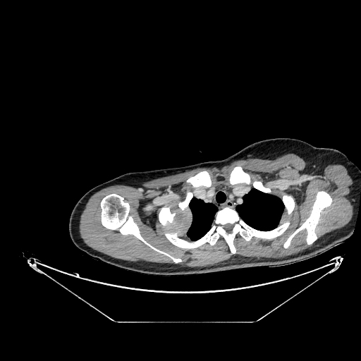
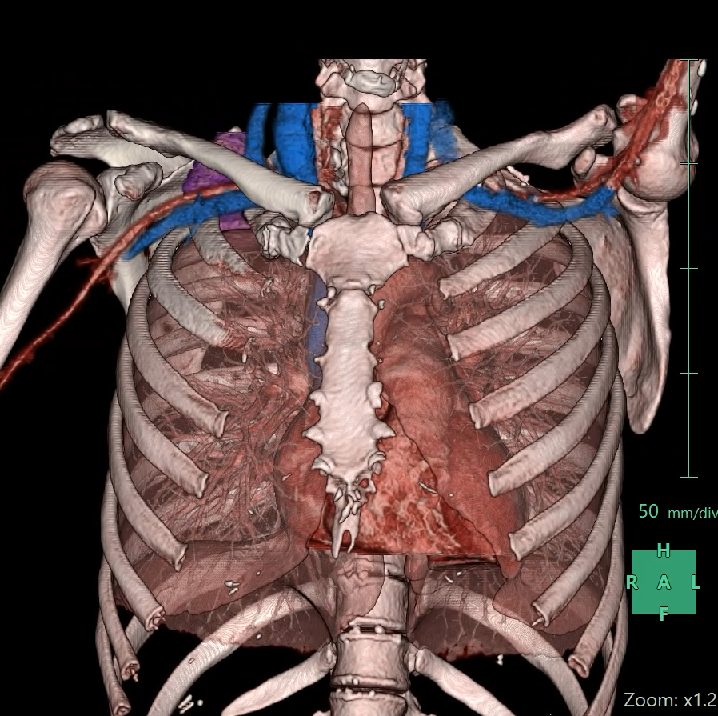
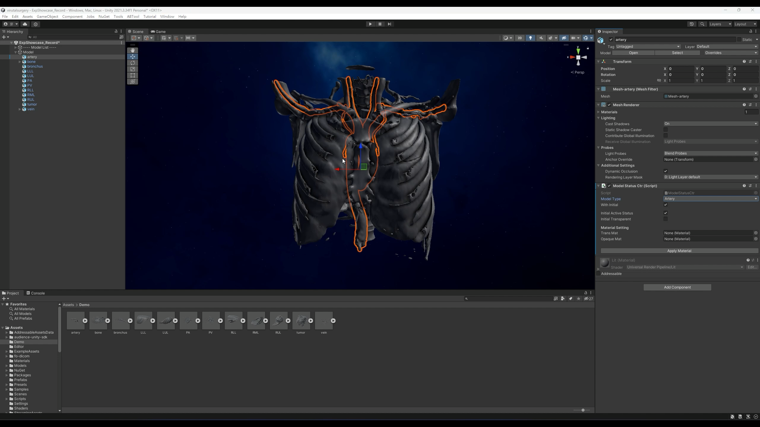
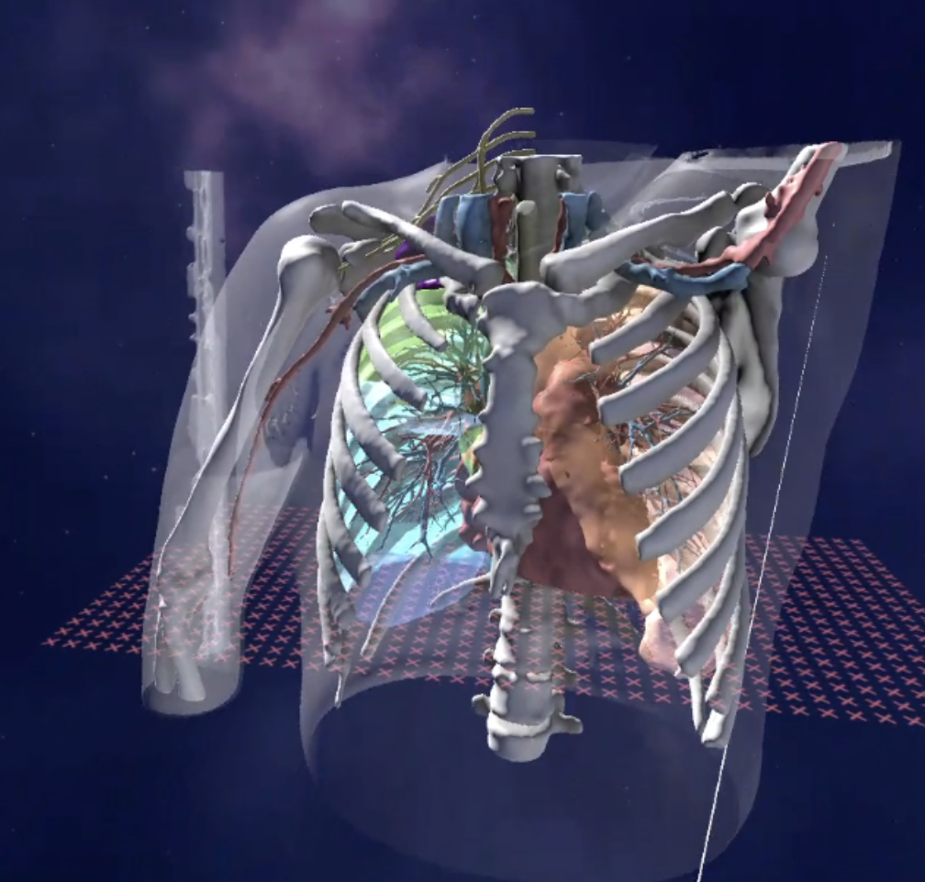
A
B
C
D
Acquire preoperative CT
Generate 3D models
Load into VR software
Immersive view with HMD
Figure ??. Schematic representation of our workflow to generate patient-specific preoperative 3D-VR models. A. Acquire preoperative computer tomography (CT) image in Digital imaging and communication in medicine (DICOM) format. B. Import the anonymized CT images into Synapse 3D workstation (Fujifilm, Tokyo, Japan) for segmentation and generation of 3D models in standard tessellation language (STL) file format. C. Load the models into our VR surgical planning platform developed with Unity (Unity Technologies, San Francisco, CA). D. Evaluation of patient-specific anatomy by the surgeon with head mounted device (HMD).

Slide 6
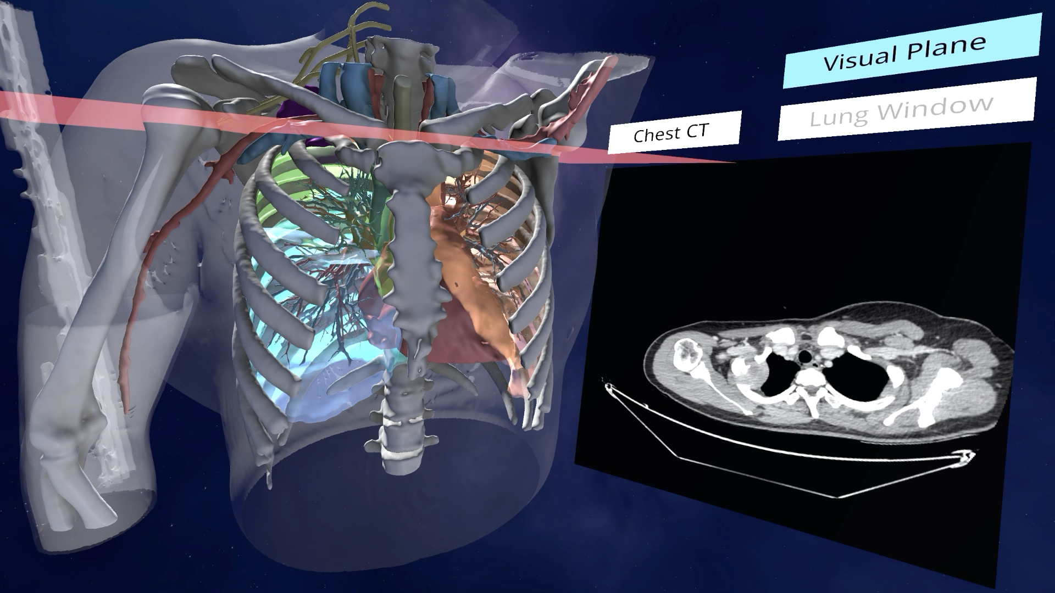
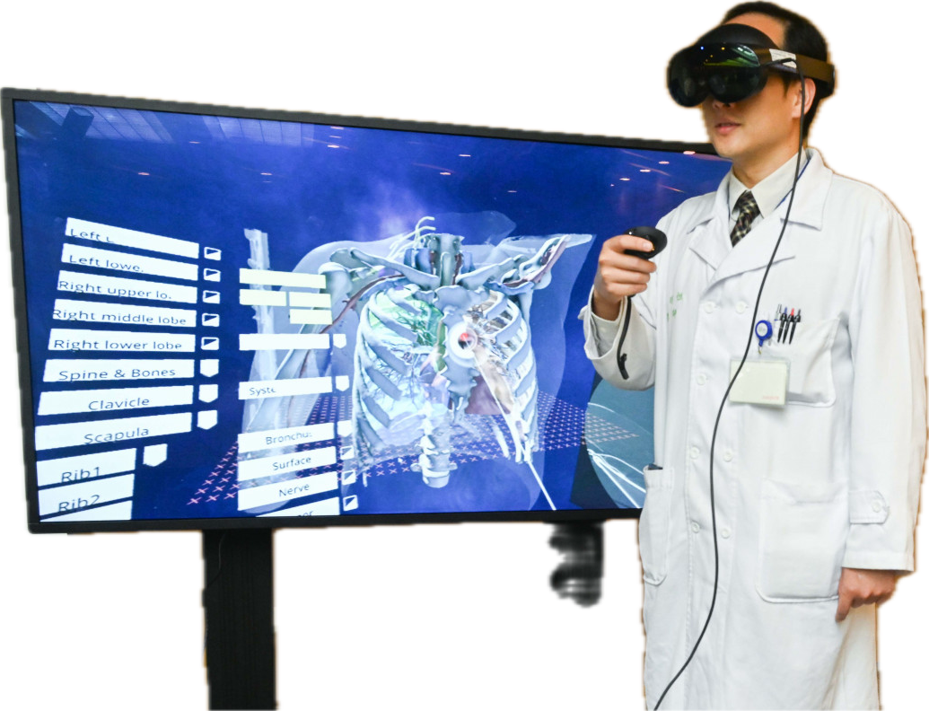
Preoperative CT
Immersive VR surgical planning
3D models

Slide 7
Import preoperative CT
Generate 3D models
Load into VR software

